Slide 1

Group Number: G22
SCS 3214 / IS 3113: Group Project II – 2021

Slide 2
Details of Project Supervisor, Co-supervisor
Group Number: G22
Group Number: G22
Proposed Project Supervisor: Ms. Kulani Sumanasekara
Proposed Project Co-Supervisor: Ms. Gayani Rupasinghe

Slide 3
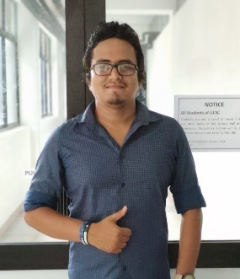
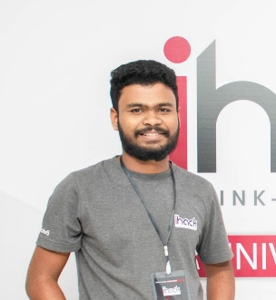
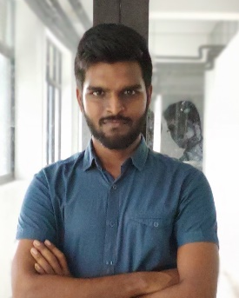
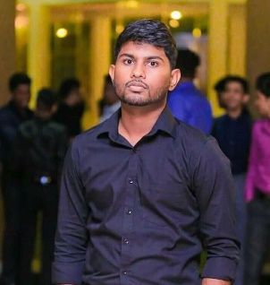
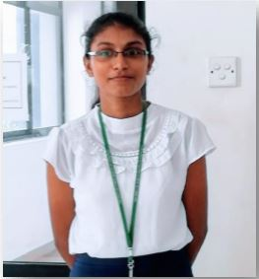
Team Members
Group Number: G22
D.M.H.U. Jayasuriya 18000746
H.L.S Prasanga 18001246
B.R.H.K. Balasuriya 18020102
W.S.S. Gunasekara 18020267
A.W.R.S. Hemachandra 18020291

Slide 4
Group Number: G22
Introduction
Problem Definition
It’s not easy to start a new business with regular customers.
There are difficulties in fulfilling the capital requirements for the Startup business.
Difficult to find quality service for the startup stage business.
There does not exist a platform for the startup business to do marketing in Sri Lanka.
There does not exist a platform for finding partners and investors for startup business in Sri Lanka.

Slide 5
Group Number: G22
Introduction of the Project
Mobile and web based development to the help startup companies to find partners, investors and clients.
Startup companies can create the account with their required details.
And they can apply for partnership from other companies and can send request to the investors.
Investors can subscribe startup companies and view more detail when get acceptances.
And they can respond for the request come from startup companies.
Client can create account and can shop the product services.
Admin will have a web application with a dashboard and user management system and a notification system.

Slide 6
Group Number: G22
Motivation to select the project
There does not exist a platform for finding partners and investors for startup business in Sri Lanka.
Nowadays, mobile phone is the best platform to build up the business connections.
There are a lot of entrepreneurs who like to start own company.
Startup companies doesn’t have right kind of method to market their business.
There are a lot of investors who likes to invest in startup.

Slide 7
Goals & Objectives
Group Number: G22
Goals
Establish a well- recognized platform for startups.
Platform to sell products and to connect with partners.
Build up a strong business community for startups.
Connect the investors with the entrepreneurs.
Enhance the opportunities for all the parties to develop and sustain this community.

Slide 8
Group Number: G22
Objectives
Provide quality service to all users with best performance.
Implement the platform for startups within the required time.
Establish short-term and long-term profitability.
Provide facilities to investors to follow up startups.
Provides features to clients to buy products through the system.
Supports the startup with the client base attracted

Slide 9
Project Scope
Group Number: G22

Slide 10
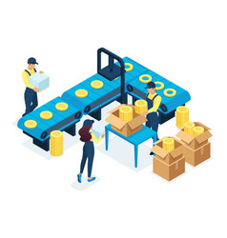
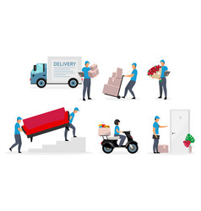



Group Number: G22
Main functionalities of the system
Considering the our system we can introduce five main actors.
Entrepreneur - Product based
Entrepreneur - Service based
Investors
Admin
Clients

Slide 11
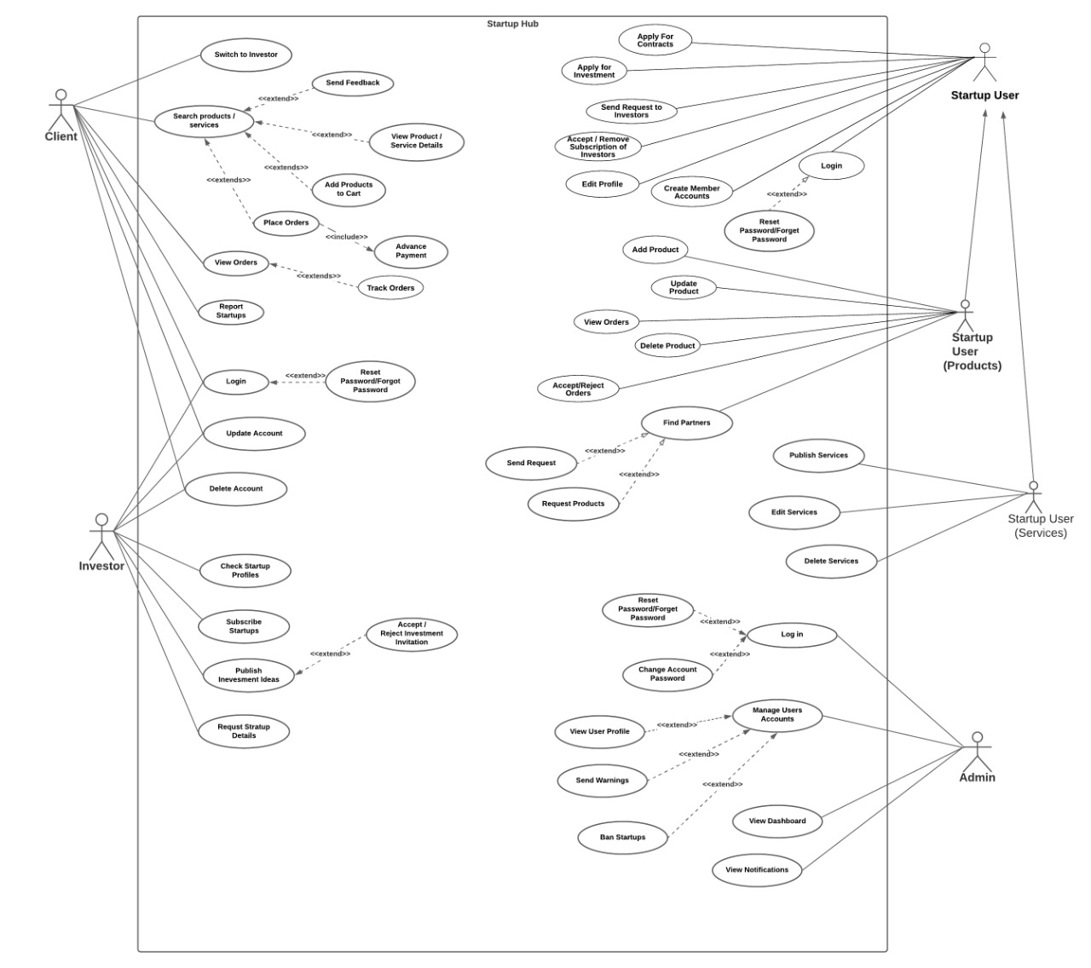
Use case Diagram
Group Number: G22

Slide 12
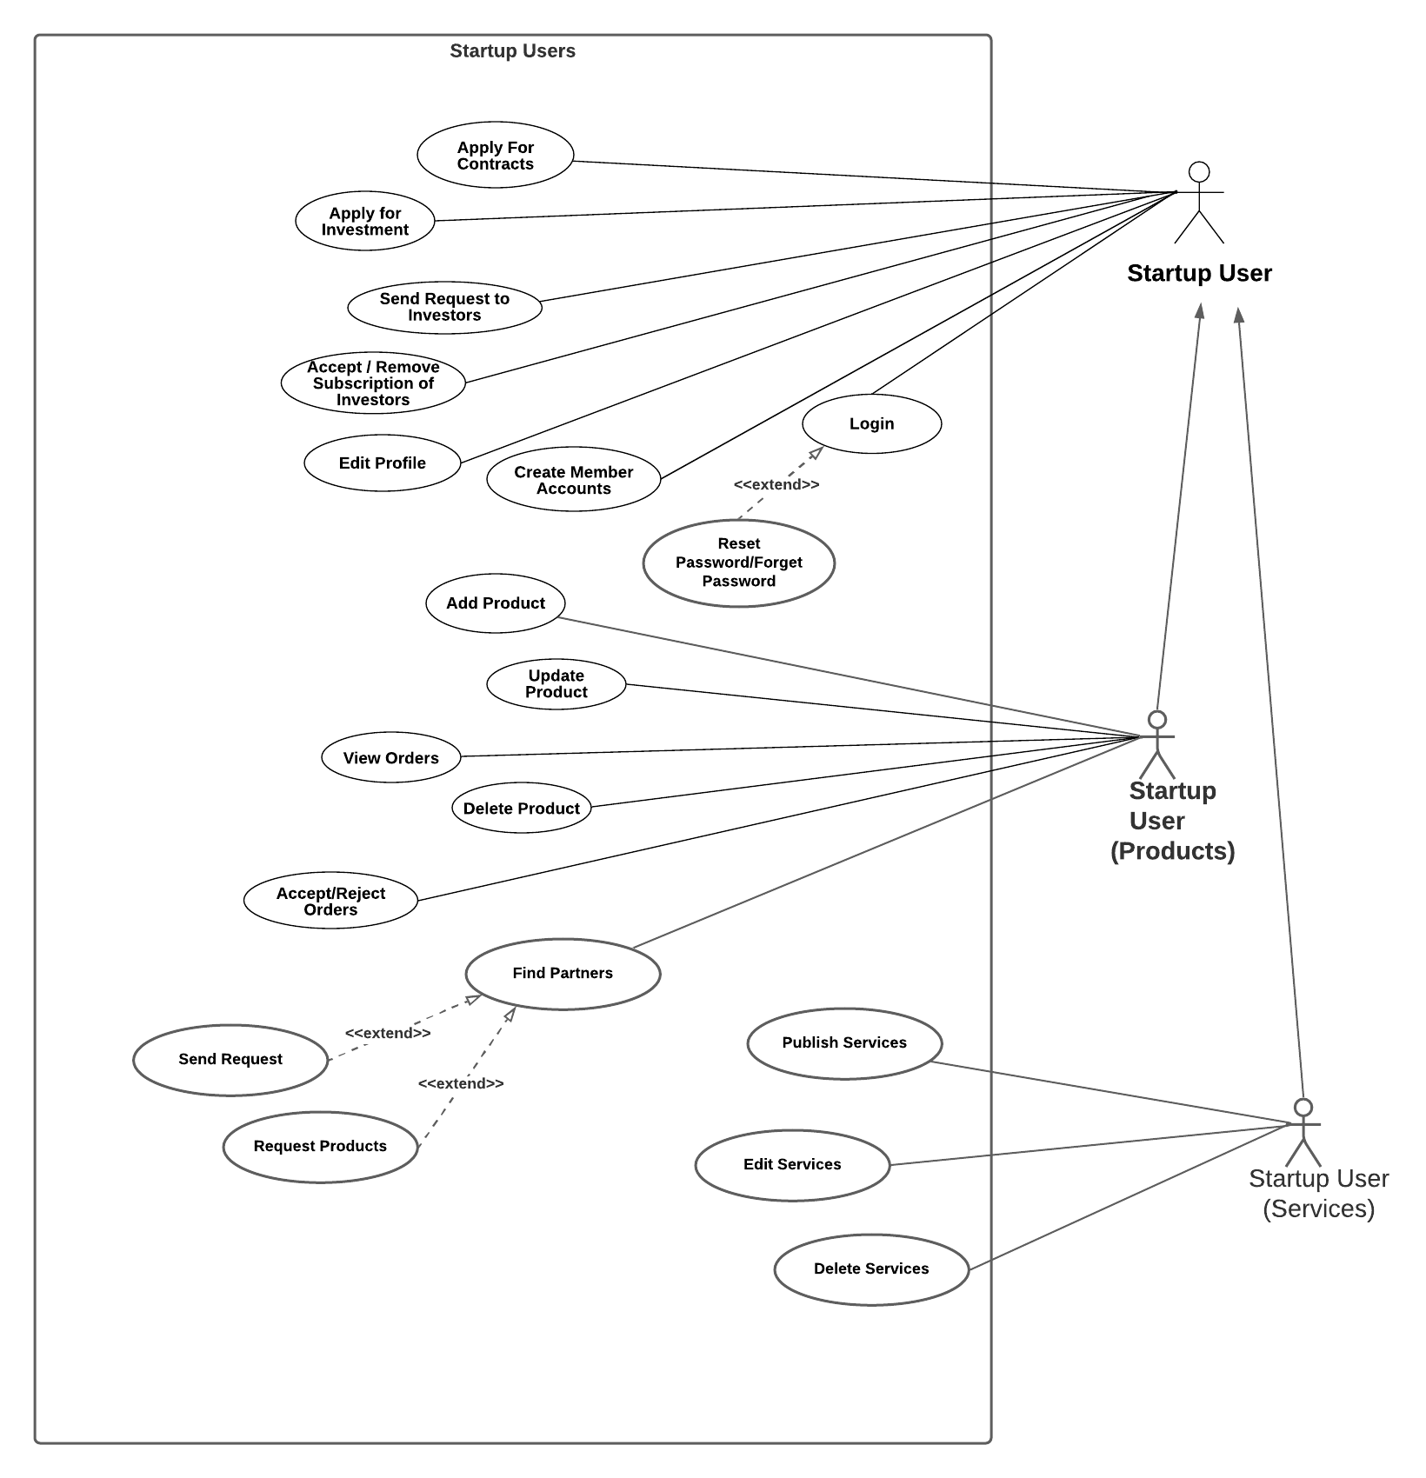
Entrepreneur
Group Number: G22

Slide 13
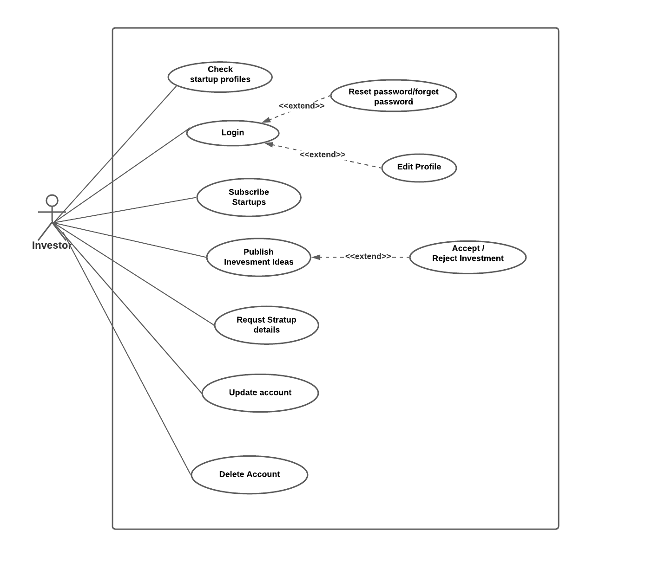
Investor
Group Number: G22

Slide 14
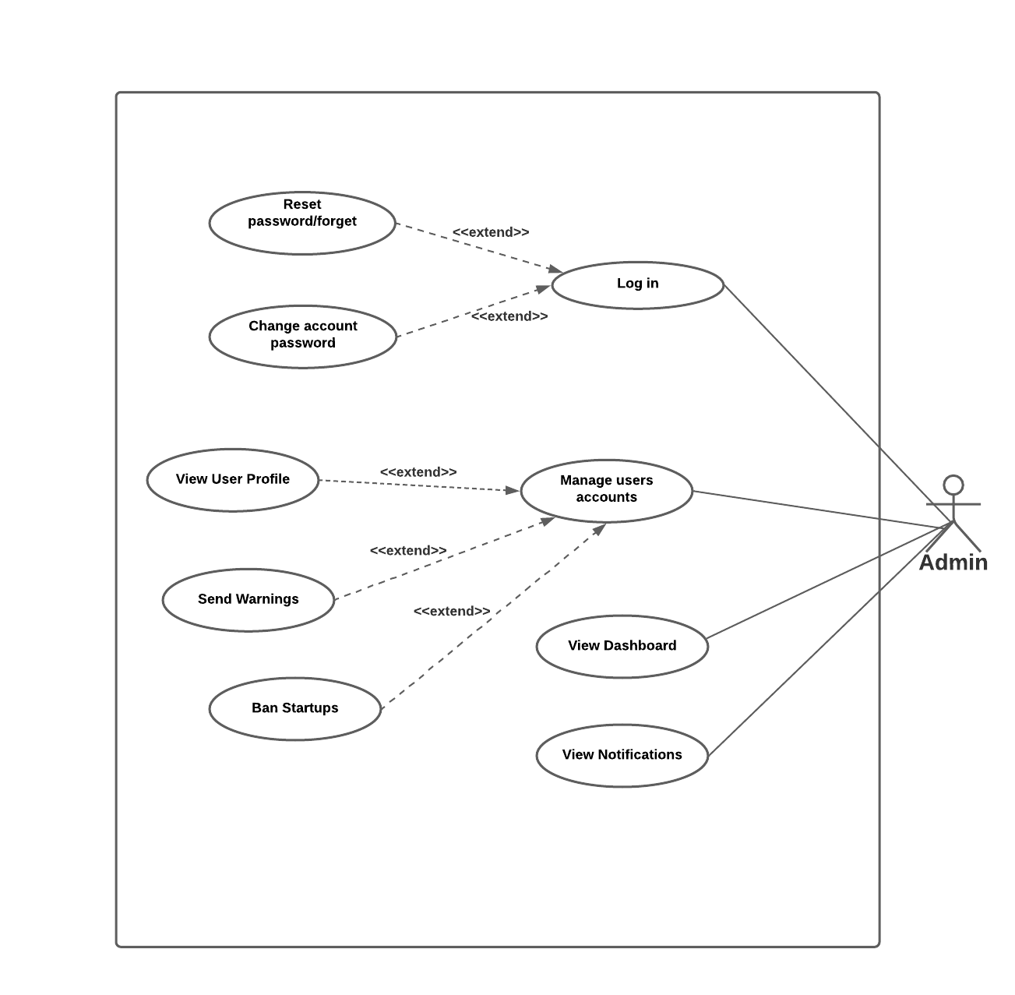
Admin
Group Number: G22

Slide 15
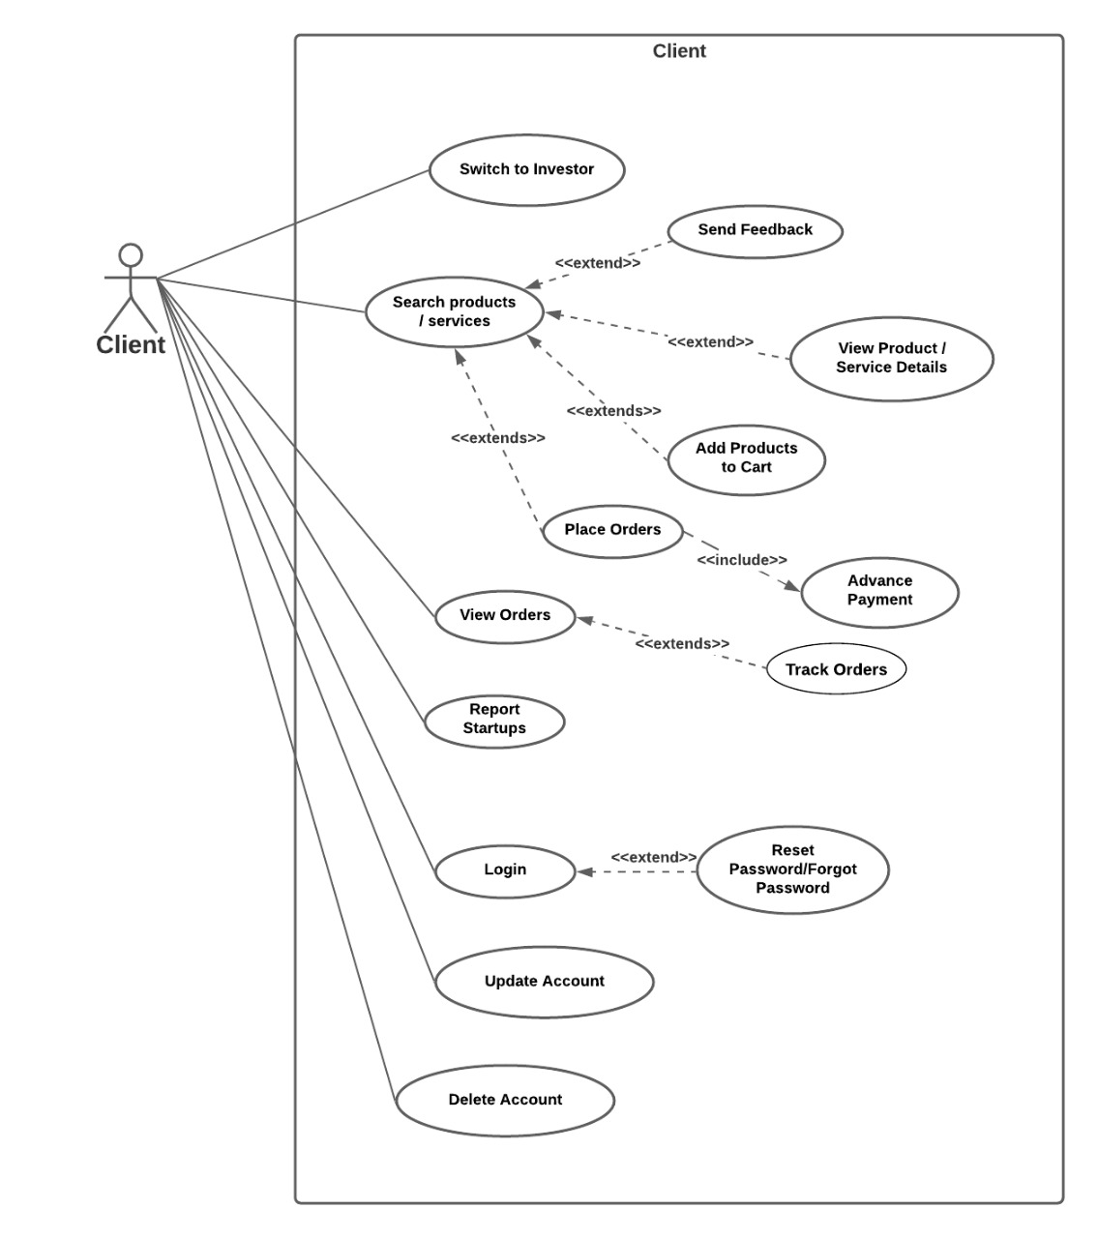
Client
Group Number: G22

Slide 16
Out of Scope
Group Number: G22
The system won't handle the legal aspect of contract happen between the investor and the entrepreneur.
The system won't manage the contract partnership.
The system won't handle the Inventory of the startups.
We are not implementing the payment gateway.

Slide 17
Quality Attributes
Group Number: G22
Security
Required passwords should be longer than 8 characters.
Password recovery option.
Save password in an encrypted manner.
Validated with the required fields.
Performance
Improve the performance by speeding the process, decrease the response time, etc.
Can distributed across two or more data centers.

Slide 18
Group Number: G22
3. Testability
Conduct the different testing methods.
Project is developing in module wise.
4. Usability
Support for both Android and iOS.
Develop in user- friendliness way.
Build with clean and clear user interfaces.
Planning to have user testing.

Slide 19
Group Number: G22
5. Availability
Support for both Android and iOS.
24 hours availability.
6. Maintainability
Use readable codes which can easily understand.
We will use comments to identify the source codes. So code can easily change.
Develop project in module wise.

Slide 20
Proposed Technologies
Group Number: G22
Technologies and frameworks expected to use for developing the projects as follows.
React Native
React Native is cross-platform.
compatible with both Android and iOS.
React components are reusable.
Hot reload facility gives immediate feedback.

Slide 21
Group Number: G22
Nodejs
Offers easy scalability.
Nodejs offers high performance and low response time .
Mongo DB
Highly scalable and flexible.
Performance and speed is higher than RDBMS.
Diagram drawing Tools - drow.io , Lucidchart
Documentations Tools - Microsoft Word , Google Docs
Editing Tools - Visual Studio Code
Contribution Platforms - GitHub , Google Drive

Slide 22
Feasibility study
Group Number: G22
Operational Feasibility
We consider our proposed App, as a good solution for the identified problem domain.
There is no other solution like this in Sri Lanka to help find business partners and investors for Startup business.
All users will get benefits through the system.

Slide 23
Feasibility study
Group Number: G22
Technical Feasibility
Technologies which are using by us, is freely available and technical skills required are manageable.
Nodejs, React Native and Mongo DB offers high performance and low response time.
React Native compatible with both Android and iOS.

Slide 24
Feasibility study
Group Number: G22
Economic Feasibility
Our cost will be zero because we are using Open source software and freely available tools.
When we publish the app in the Play Store, additional cost will be added.
We are expecting to include an annual membership fee for every user.

Slide 25
Feasibility study
Group Number: G22
Legal and Ethical Feasibility
We are using freely available tools and open source software so there is no issues with licenses.
System will not save the customers’ sensitive data like credit card information.
We are not responsible for the legal activities between investors and the Startup companies.
We take action for the complaint about false data and inappropriate data within System.

Slide 26
Feasibility study
Group Number: G22
Schedule Feasibility
The Project should be completed in 15 Weeks. Therefore, estimated man-hours for the project will be as follows.
Weekdays working hours in the schedule = 4
Weekends working hours = 2
Number of members = 5
Man-hours per week = (4+2)*5 = 30
Estimated number of weeks = 15
Estimate Total of Man-hours = 15*30
= 450

Slide 27
The Project Plan
Group Number: G22
We are planning to follow SCRUM methodology in this software development process.
Main scrum roles as follows,
• Product Owner - Supervisor
• Scrum Master – Co-Supervisor
• Development Team - Team members
Development process divided into main 4 sprints.
Interconnection of the components will be tested through out the development process.
Developments process is happening with the testing so we can identify the correctness of the each component.

Slide 28
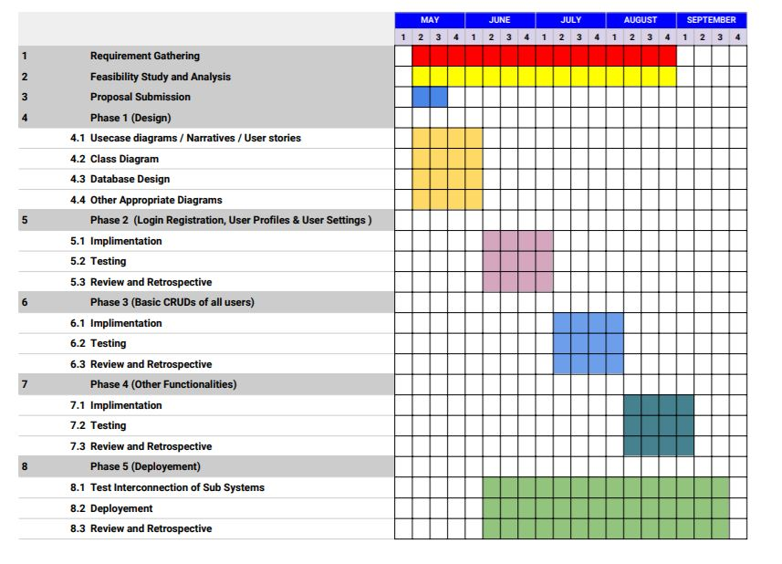
Group Number: G22
Time based work distribution

Slide 29
Work Load Distribution
Group Number: G22
We distribute our main functionalities as follows,
Admin functionalities – by B.R.H.K. Balasuriya
Investor functionalities – by W.S.S. Gunasekara
Client functionalities – by H.L.S Prasanga
Entrepreneur- Product functionalities – by D.M.H.U. Jayasuriya
Entrepreneur- Service functionalities - by A.W.R.S. Hemachandra

Slide 30
THANK YOU
Group Number: G22

